Slide 1
Quality Management System for Software Development
Gijsbert Bol

Slide 2
Introduction (1)
UMCU computer science team
4 core members
Clinical software
Delineation software
Dicomserver
Workflow software
Pre-clinical software
MRLTP
Tracking/gating software
Autosegmentation
MR patches
Research software

Slide 3
Introduction (2)
Archiving, versioning and documentation
Source code repositories
Git
Test reports
Responsibility
Clinical physics
First-in-man MRLinac treatment (2017)
Relied heavily on in-house software
Technical file required
IGZ and internal METC
Regulations? Norms?
2020!!!

Slide 4
Regulations and Norms
MDD 93-42EEG Medical Devices Directive
MDR-2017/745 Medical Device Regulations

Slide 5
Regulations and Norms
MDD 93-42EEG Medical Devices Directive
MDR-2017/745 Medical Device Regulations
ISO 13485 Medical devices – Quality management systems - Requirements for regulatory purposes
ISO 14971 Medical devices - Application of risk management to medical devices
ISO/IEC 62304 Medical device software Software life cycle processes

Slide 6
Regulations and Norms

Slide 7
Legal framework
Medical Device Regulation 2017 (MDR)
MDR aims:
Balances patient care and small / medium-sized enterprice interests
High standard regarding quality and safety regarding MDs
Data generated by MDs are reliable and robust
Protection of subjects participating in clinical investigations
Applies to the whole EU
Adopted from May 26th, 2020

Slide 8
Medical device definition
Any instrument, apparatus, appliance, software, implant, reagent, material or other article intended by the manufacturer to be used, alone or in combination, for human beings for one or more of the following specific medical purposes:
Diagnosis, prevention, monitoring, prediction, prognosis, treatment, compensation or alleviation of disease, injury or disability
Investigate, replacement or modification of anatomy or a physiological or pathological process

Slide 9
Software can be a medical device
MDR definition:
Software shall also be deemed to be an active device
Active device:
Any device, the operation of which depends on a source of energy and which acts by changing the density of or converting that energy
Software can be regarded as a medical device with a power cord

Slide 10
Classification (ISO 13485)
Governed by the intended purpose of the devices
Software, which drives a device or influences the use of a device, shall fall within the same class as the device
If the software is independent of any other device, it shall be classified in its own right
Classification determines the extend in which a appropriate authority assess the development process and the documentation
Notified body (CE)
IGZ

Slide 11
Classification (ISO 13485)
Provides information to take decisions with diagnosis or therapeutic purposes
class IIa
Except:
Death or an irreversible deterioration of a person's state of health
class III
Serious deterioration of a person's state of health or a surgical intervention
class IIb

Slide 12
Classification (ISO 13485)
Monitor physiological processes
class IIa
Monitor vital physiological processes, variation of the parameter may result in immediate danger to patient
class IIb
All other:
class I
MEDDEV 2.4/1 rev. 9
CE certification by a notified body needed:
Class IIa, IIb, III

Slide 13
Classification (IEC 62304)

Slide 14
Hospitals (1)
Manufacturing, modifying and using devices in-house
On a non-industrial scale
Specific needs of target patient groups which cannot be met at the appropriate level of performance by an equivalent device available on the market
Within the an hospital setting, it is appropriate to provide that certain rules of MDR should not apply, since the aims of this MDR should still be met in a proportionate manner.

Slide 15
Hospitals (2)
Software is not transferred to another legal entity
Software is developed and used under a appropriate quality management system (QMS)
Prove and document that other commerical software is not available for the target patient group’s specific needs
Provides information to the authorities:
Justifying the development, modification and use of the software
Understanding the development process, design and indended use of the sofware
Asserting the general safety and performance requirements

Slide 16
Hospitals (3)
Publicly declare that the software meets the general safety and performance requirements
Hospital reviews experience gained
Takes all necessary corrective actions

Slide 17
General software development requirements (1)
Risk management plan
Identify foreseeable hazards
Estimate risks during intended use and foreseeable misuse
Eliminate or control the estimated risks
Evaluate the impact and amend control measures

Slide 18
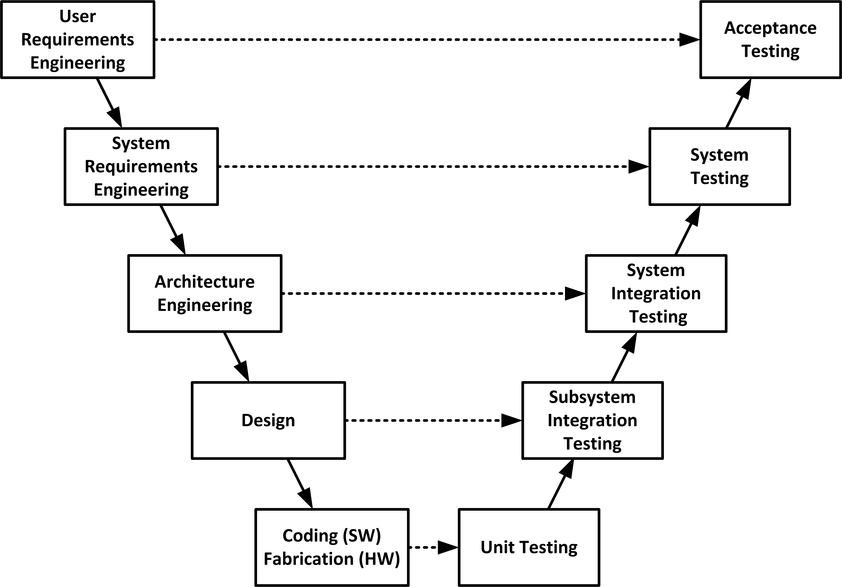
General software development requirements (2)
Design and development
Software development life cycle
V-model:

Slide 19
General software development requirements (3)
Technical documentation
Specification, requirements, design, development, safety
Verification and validation
Verification: Are we building the system right?
Validation: Are we building the right system?
Pre-clinical and clinical data

Slide 20
Quality Management System (1)
Provides:
QMS user roles: task / responsibility / competence
Procedures
Risk managment procedures
Quality management procedures
Development procedures
Forms
Stores for each software project:
Risk analyis data
Verification and validation data
Test data
Produces for each software project:
Technical file
Notified body (CE)
IGZ

Slide 21
Quality Management System (2)

Slide 22
Quality Management System (3)
Norms:
ISO 13485 and ISO 14971
General QMS for medical devices
ISO 62304
QMS for medical software
Software development life cycle processes
QMS certification:
A QMS can be certified under ISO 13485 and ISO 14971 only

Slide 23
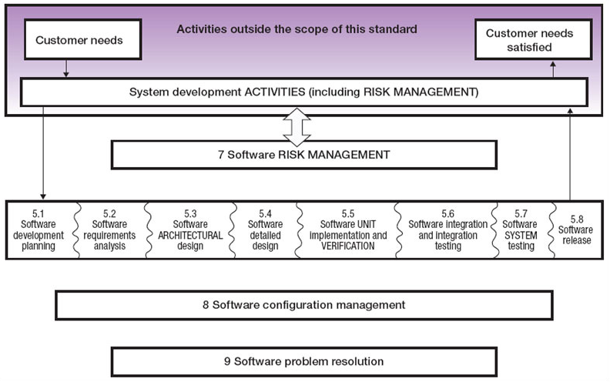
ISO 62304 overview

Slide 24
UMCU implementation
Git
Latex
PDF publishing
Electronic signing

Slide 25
UMCU implementation
Git
Latex
PDF publishing
Electronic signing
Git server
gitolite
Build (unit) test system
maven
Document Management System
Review/approve
seeddms
Issue tracker

Slide 26
Involvement
Requirements
Risk analysis
Implementation
Testing

Slide 27
FAQ
Is configuring == programming?
No!
Within intended use of manufacturer
Can scripts be medical devices?
Yes!
Medical device definition in MDR
Independent of programming language
Within intended use of manufacturer
Can Excel sheets be medical devices?
Yes!
Medical device definition in MDR
Can programs / scripts / Excel sheets be shared?
Only with a CE mark

Slide 28
Links
Praktijkgids Medische Informatietechnologie (2018)
https://mtintegraal.nl/specials/1/speciale-uitgave-praktijkgids-medische-informatietechnologie
“HET ONTWIKKELEN VAN MEDISCHE SOFTWARE IS EEN VAK WAARBIJ JE ONDER ANDERE ERVAREN ONTWIKKELAARS, PROJECTLEIDERS EN ARCHITECTEN NODIG HEBT. HET IS STERK AF TE RADEN ZELF TE ONTWIKKELEN ALSDEZE ERVARING EN KENNIS NIET IN HUIS IS.”

Slide 29
Conclusions
Adhere to norms
ISO 62304, ISO 13485 and ISO 14971
Implement a software QMS
Procedures, roles, records
Programs, scripts and Excel sheets
Setup team for each software project
Developers (risk analysis, implementation, testing)
Clinical physicists (requirements, risk analysis, testing)
End users (requirements, risk analysis, testing, bug reports)

