Slide 1
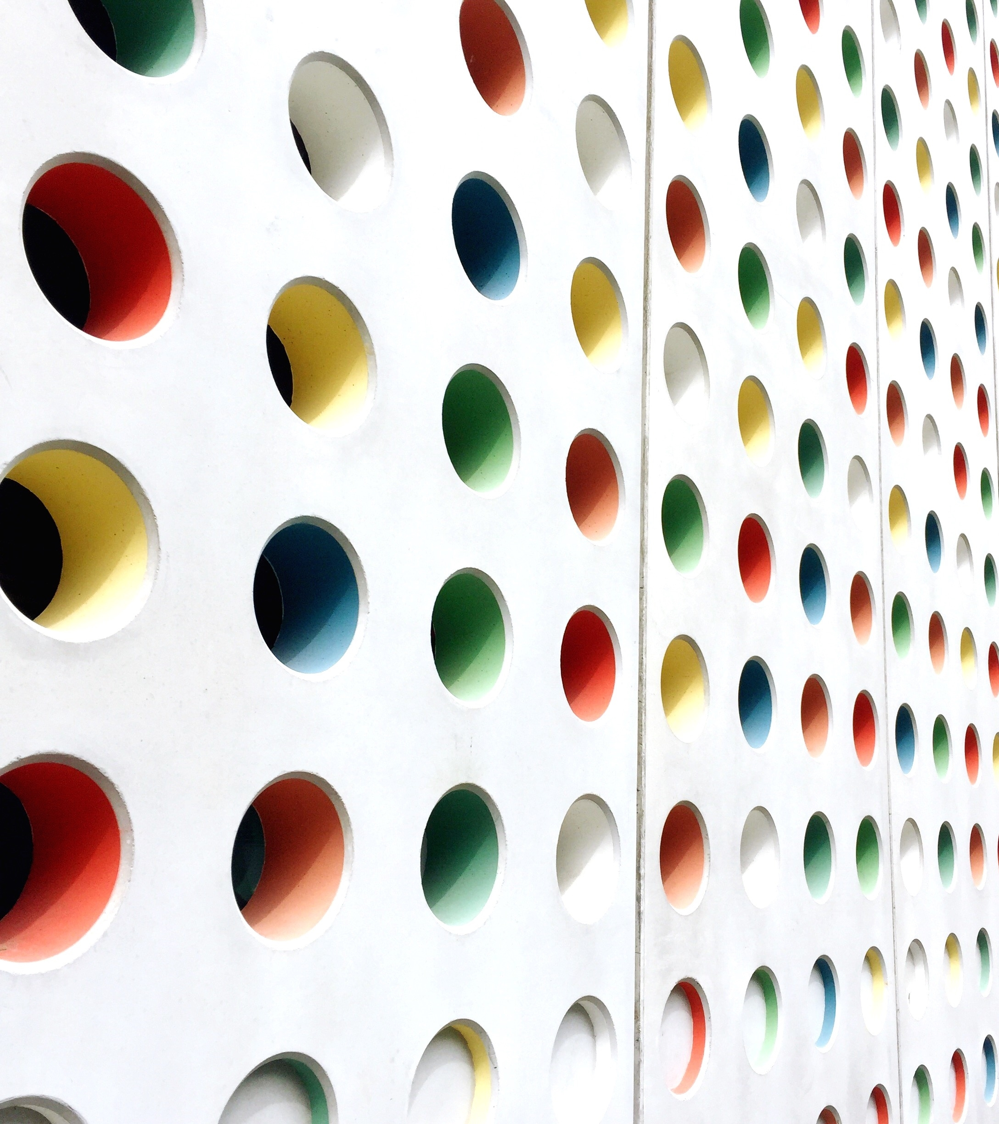
RT-24
Workgroup radiotherapy Belgium 2023-05-25
BelDART+External beam audit
Chair: Bert bakelandt

Slide 2
BELdART + external dosimetry audit audit
Scope of the meeting:
discuss BELdART results + give feedback to the steering committee
discuss mandatory external dosimetry audits to come to a conclusion at the RT-24 live meeting

Slide 3
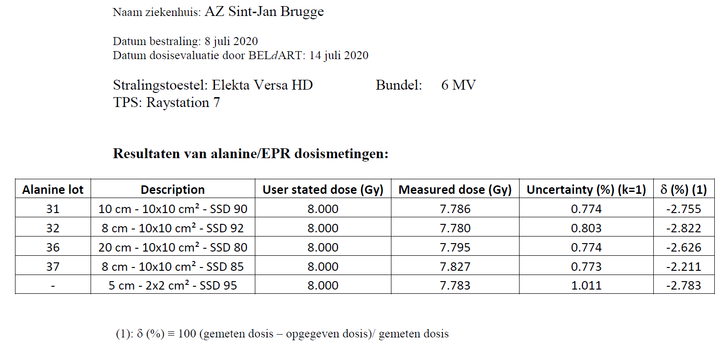
BELdART dosimetry audit: 1 example

Slide 4
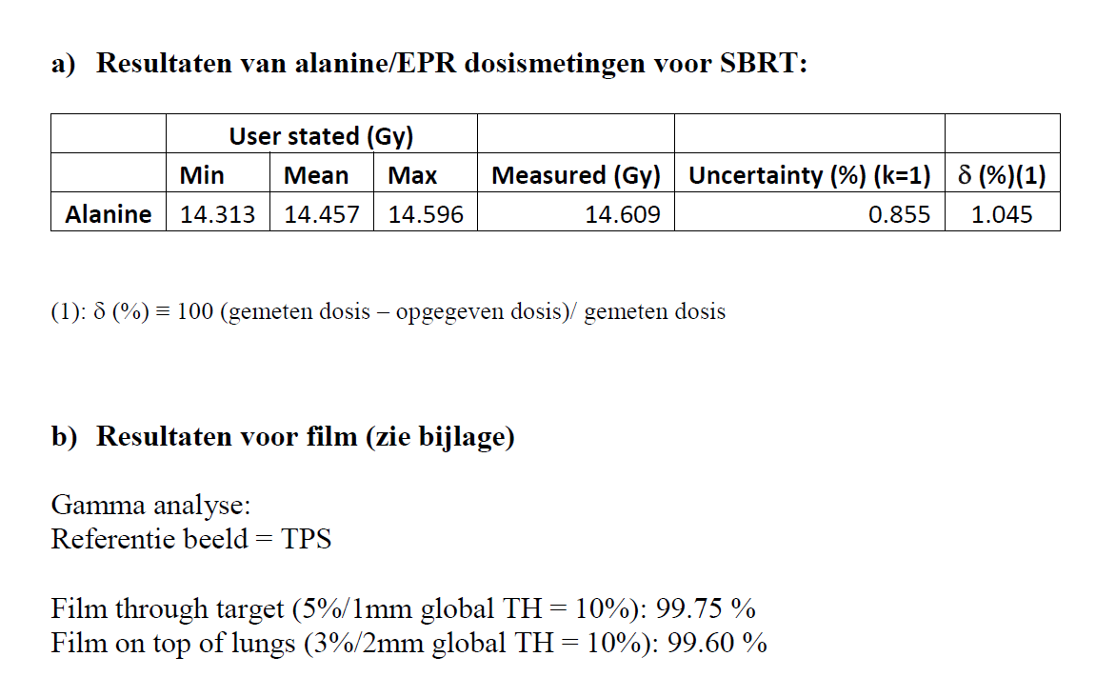
BELdART dosimetry audit: 1 example

Slide 5
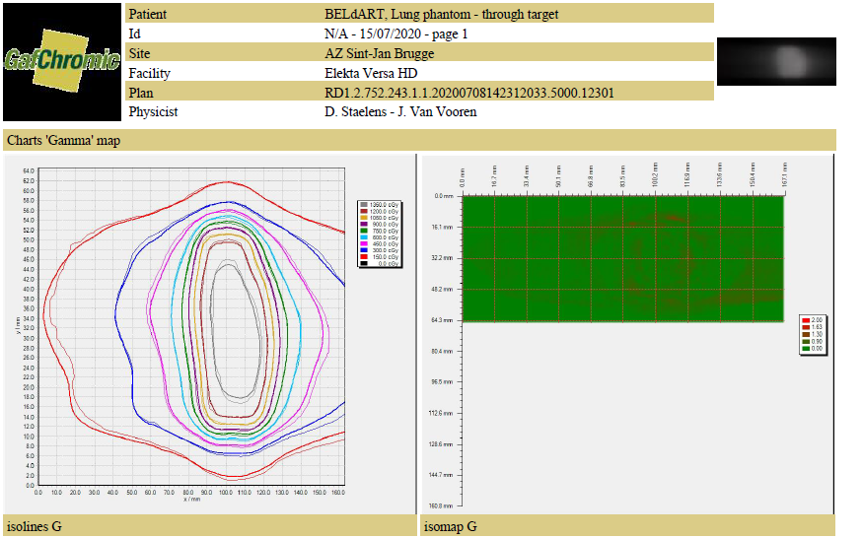
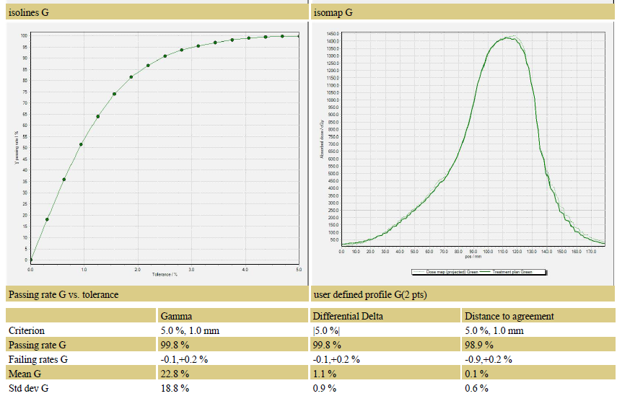
BELdART dosimetry audit: 1 example

Slide 6
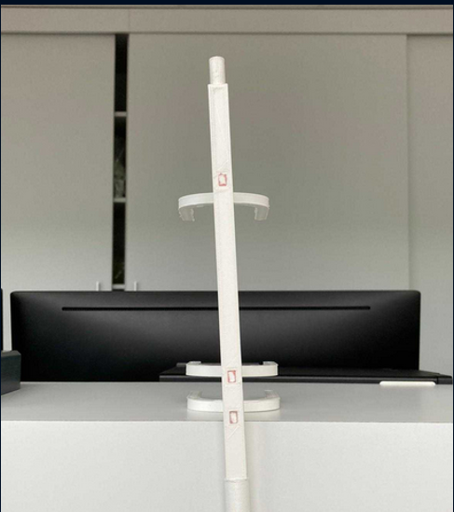
BELdART dosimetry audit

Slide 7
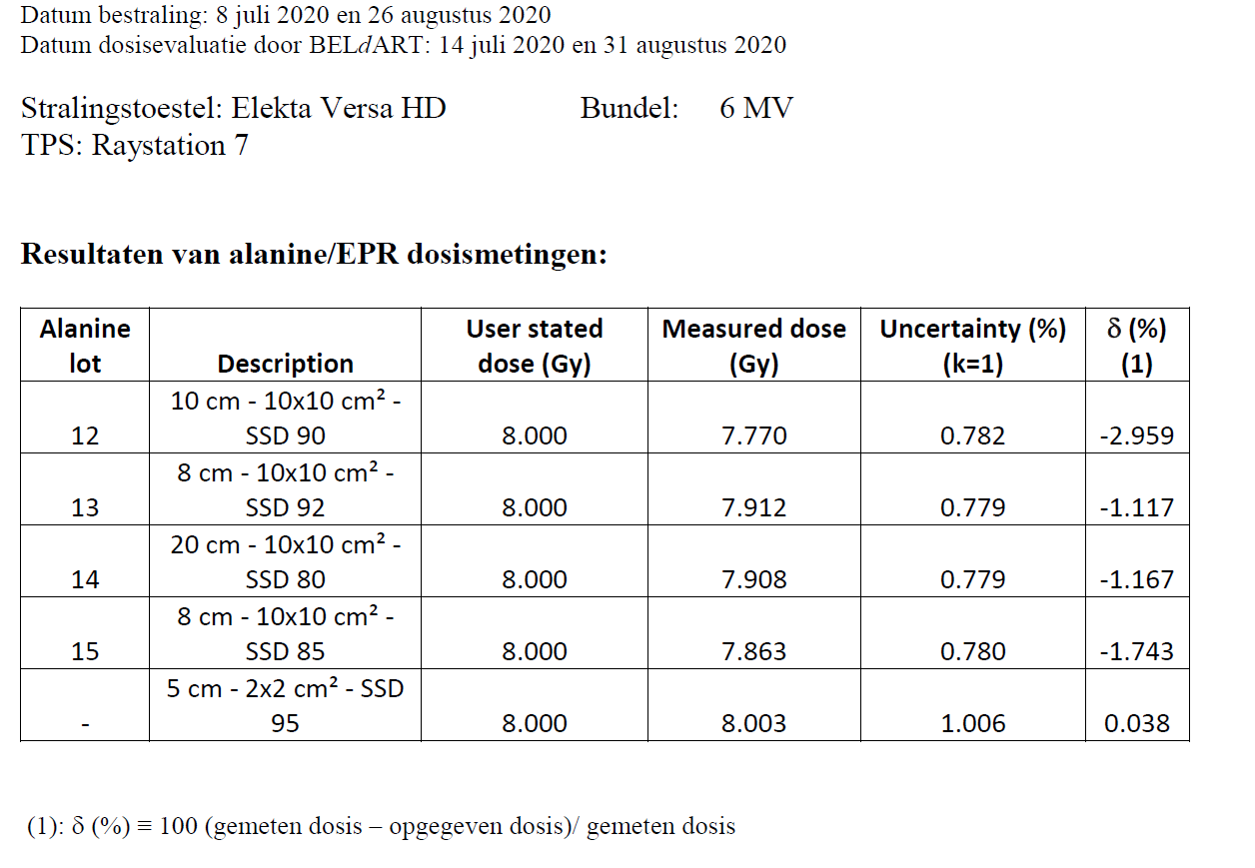
BELdART dosimetry audit

Slide 8
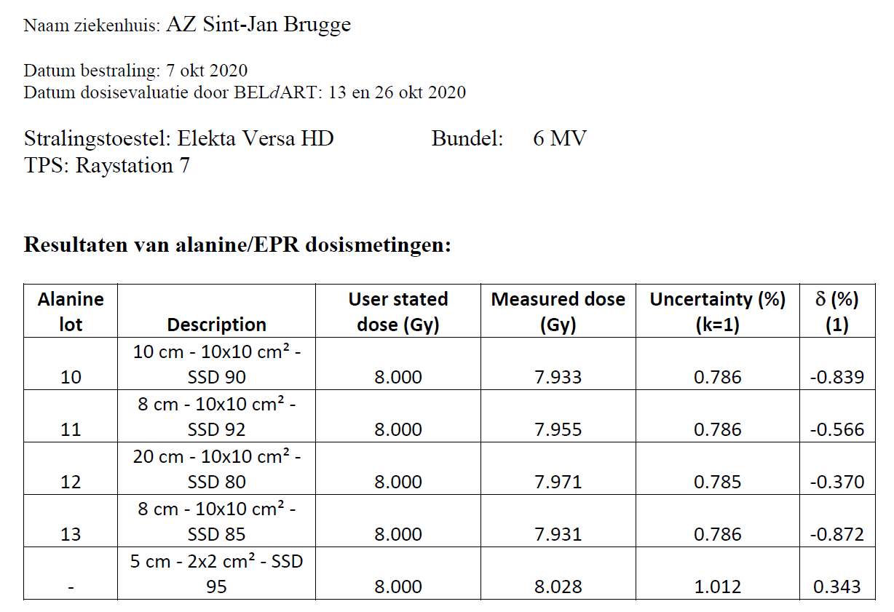
(BELdART ) dosimetry audit

Slide 9
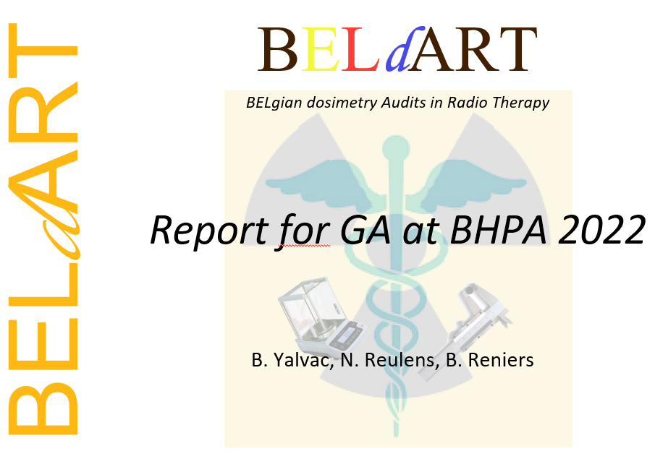
(BELdART ) dosimetry audit

Slide 10
Dosimetry with alanine
Irradiation of the amino acid alanine produces stable free radicals:
The concentration of the radicals is proportional to the absorbed dose and can be measured by Electron Paramagnetic Resonance (EPR) spectroscopy
M. Anton, Applied Radiation and Isotopes 62 (2005), 779–795

Slide 11
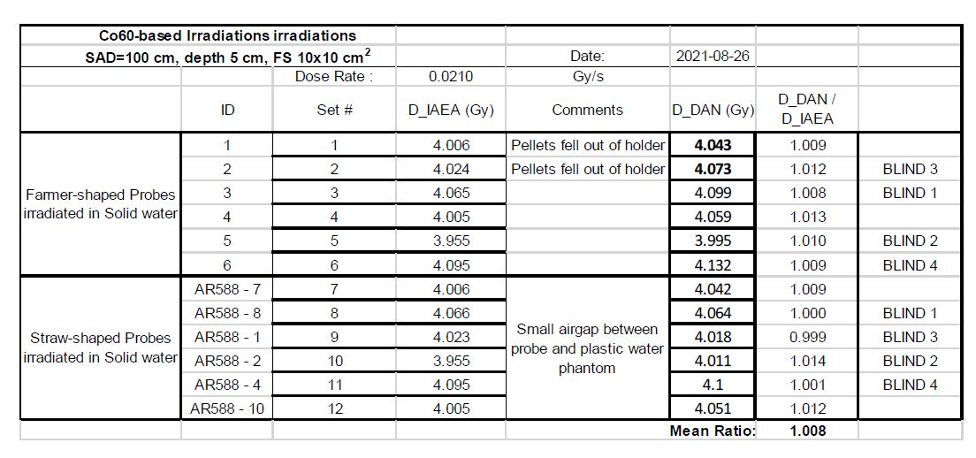
Results IAEA blind irradiations
Co-60 beams
Co-60 beams

Slide 12
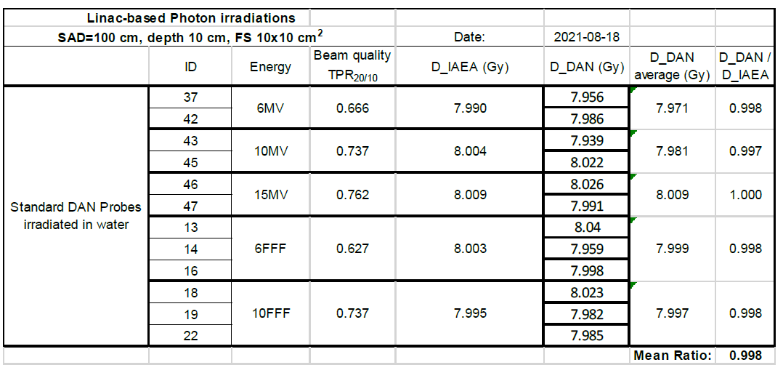
Results IAEA blind irradiations
Linac based (using BELdART holder)

Slide 13
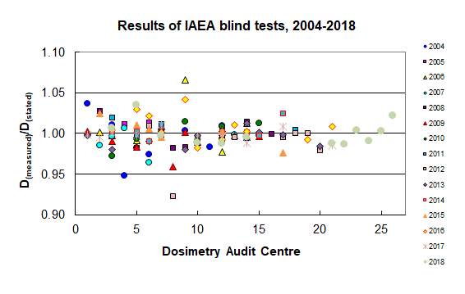
Results IAEA blind irradiation tests
Results other DAN’s
https://dosimetry-audit-networks.iaea.org/Home/AuditQA

Slide 14
Uncertainties obtained from PTB
primary standard | 0.30%
test probes | 1.10%
reproducibility of irradiation | 0.50%
irradiation temperature | 0.10%
intrabatch homogeneity | 0.15%
average mass of n probes | 0.05%
ESR amplitude | 0.67%
fading correction | 0.09%
environment irradiation different from cal. | 0.50%
radiation quality different from Co-60 or Cs-137 | 0.45%
base function | 0.25%
reproducibility of irradiation | 0.05%
irradiation temperature | 0.05%
intrabatch homogeneity | 0.15%
average mass of n probes | 0.05%
ESR amplitude | 0.11%
"systematic" part (batch hl02/kapL et al.) | 0.15%
A_{D}
25 | : dose of basis pellets in Gy
4 | : number of base pellets (4 or 8)
4 | : dose of test pellet in Gy
4 | : number of test pellets per dose
0.3% | : intrabatch homogeneity, single pellet
0.020 | : individual background A_{m (single pellet)} in Gy
0.050 | : repeatability A_{m (single pellet)} in Gy
Relative combined standard uncertainty u(N) / N = | 1.164%

Slide 15
BELdART-1 => other BELdARTs
Dose verification of basic and dynamic RT techniques in Belgium
4 objectives:
Basic dosimetric check of MVX beams
Subset of BELdART tests
Mailing audit based on BELdART-1 protocols using dedicated holder
Dynamic RT (IMRT, tomo, RA, VMAT, SRS, SBRT, ...)
Mailing audit: phantom preloaded with alanine dosimeters & film
Scientific committee in collaboration with BHPA
MeV Electron audits
Benchmarking with IAEA for the alanine

Slide 16
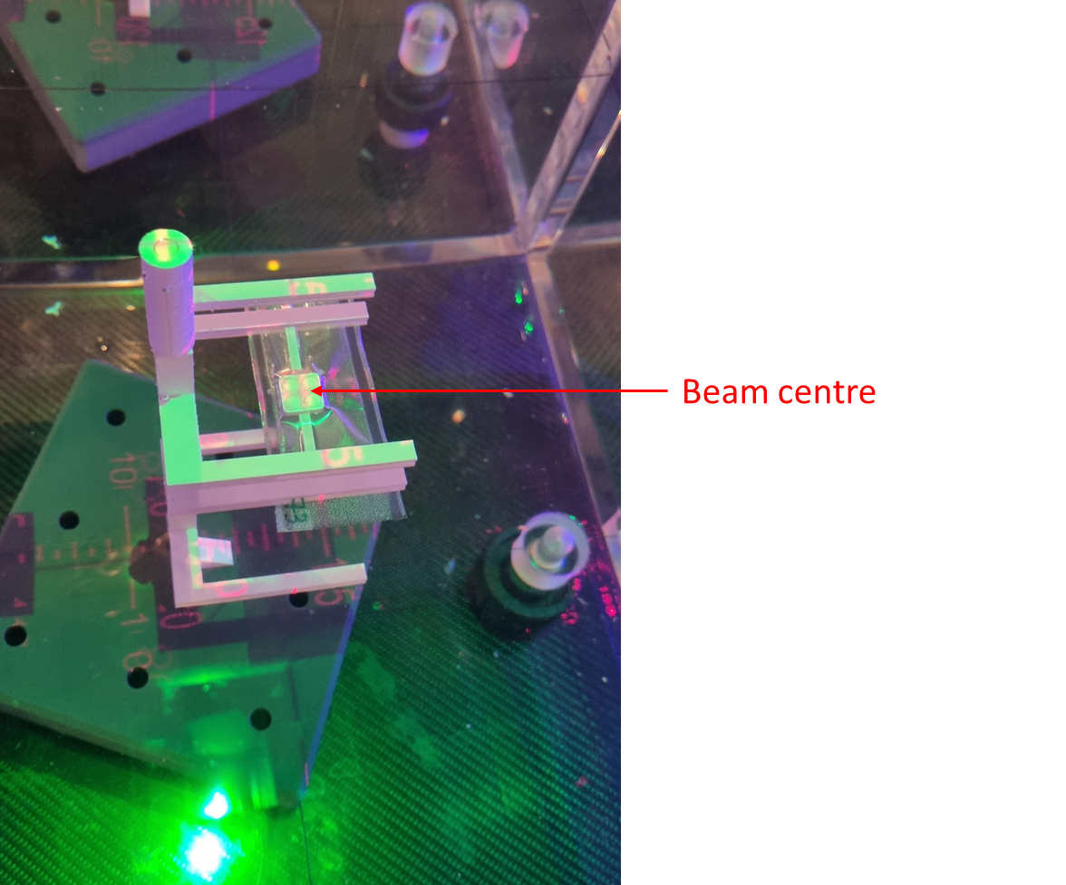
Basic audit: standard linacs
Test 1 and 2: reference beam output
8 Gy at the usual at 8cm, 10cm and at 20cm in SSD or SAD technique as is used for clinic with a vertical beam set up and a 10 x 10 cm² field.
Test 2b: output wedged field (if used clinically, on special request)
8 Gy should be delivered at 8 cm depth in water. Half the dose (4 Gy) should be administered for a wedge orientation corresponding to a 0° and 180° collimator rotation respectively
Test 3: beam output for different SSD
8 Gy at 8cm for SSD 85 with a vertical beam set up and a 10 x 10 cm² field.
Test 4: output small Field > 2x2cm²
Solid phantom: 8 Gy at 5cm water equivalent
Future: back to water!

Slide 17
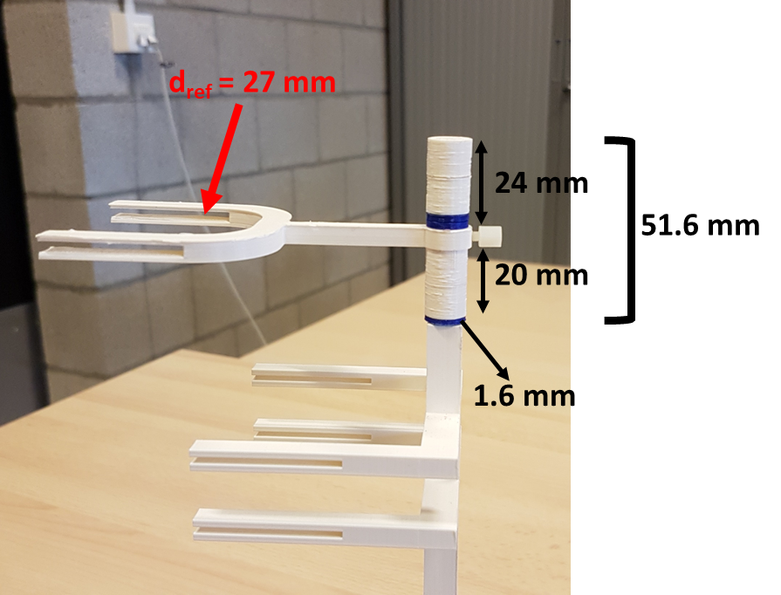
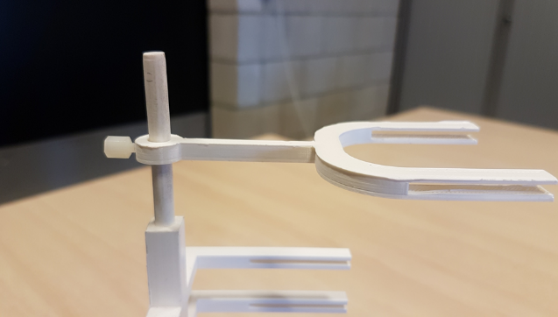
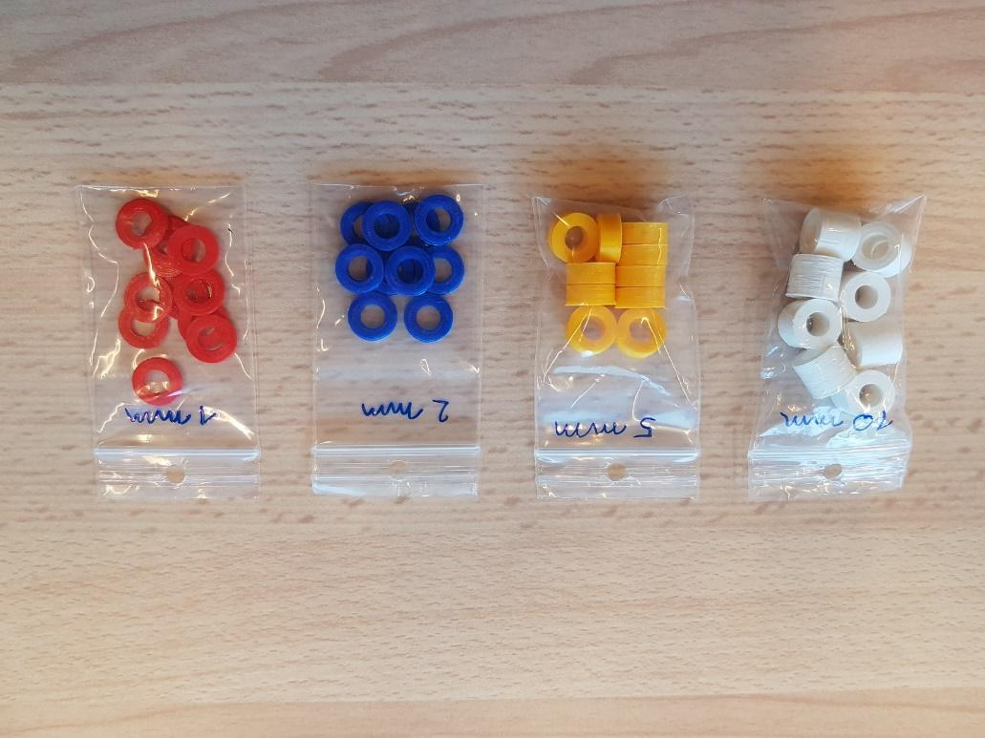
Electron beams
Use of spacers to reach Z ref

Slide 18
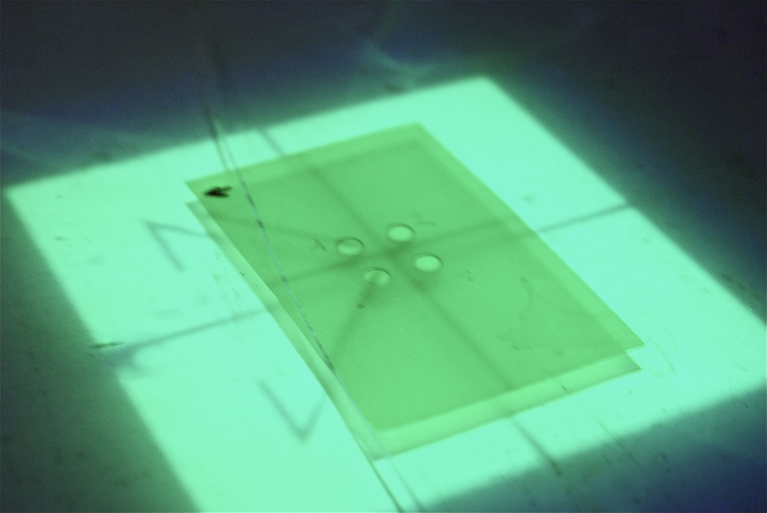
Film dosimetry: EBT3 & EBT-XD
Calibration $\sim$ 0, 1, 2, 4, 8, 16, (32) Gy
against alanine for 8Gy and 16Gy
”One scan dosimetry” used in the hospitals to free us from time and environmental constraints
Intercomparison with IAEA in progress

Slide 19
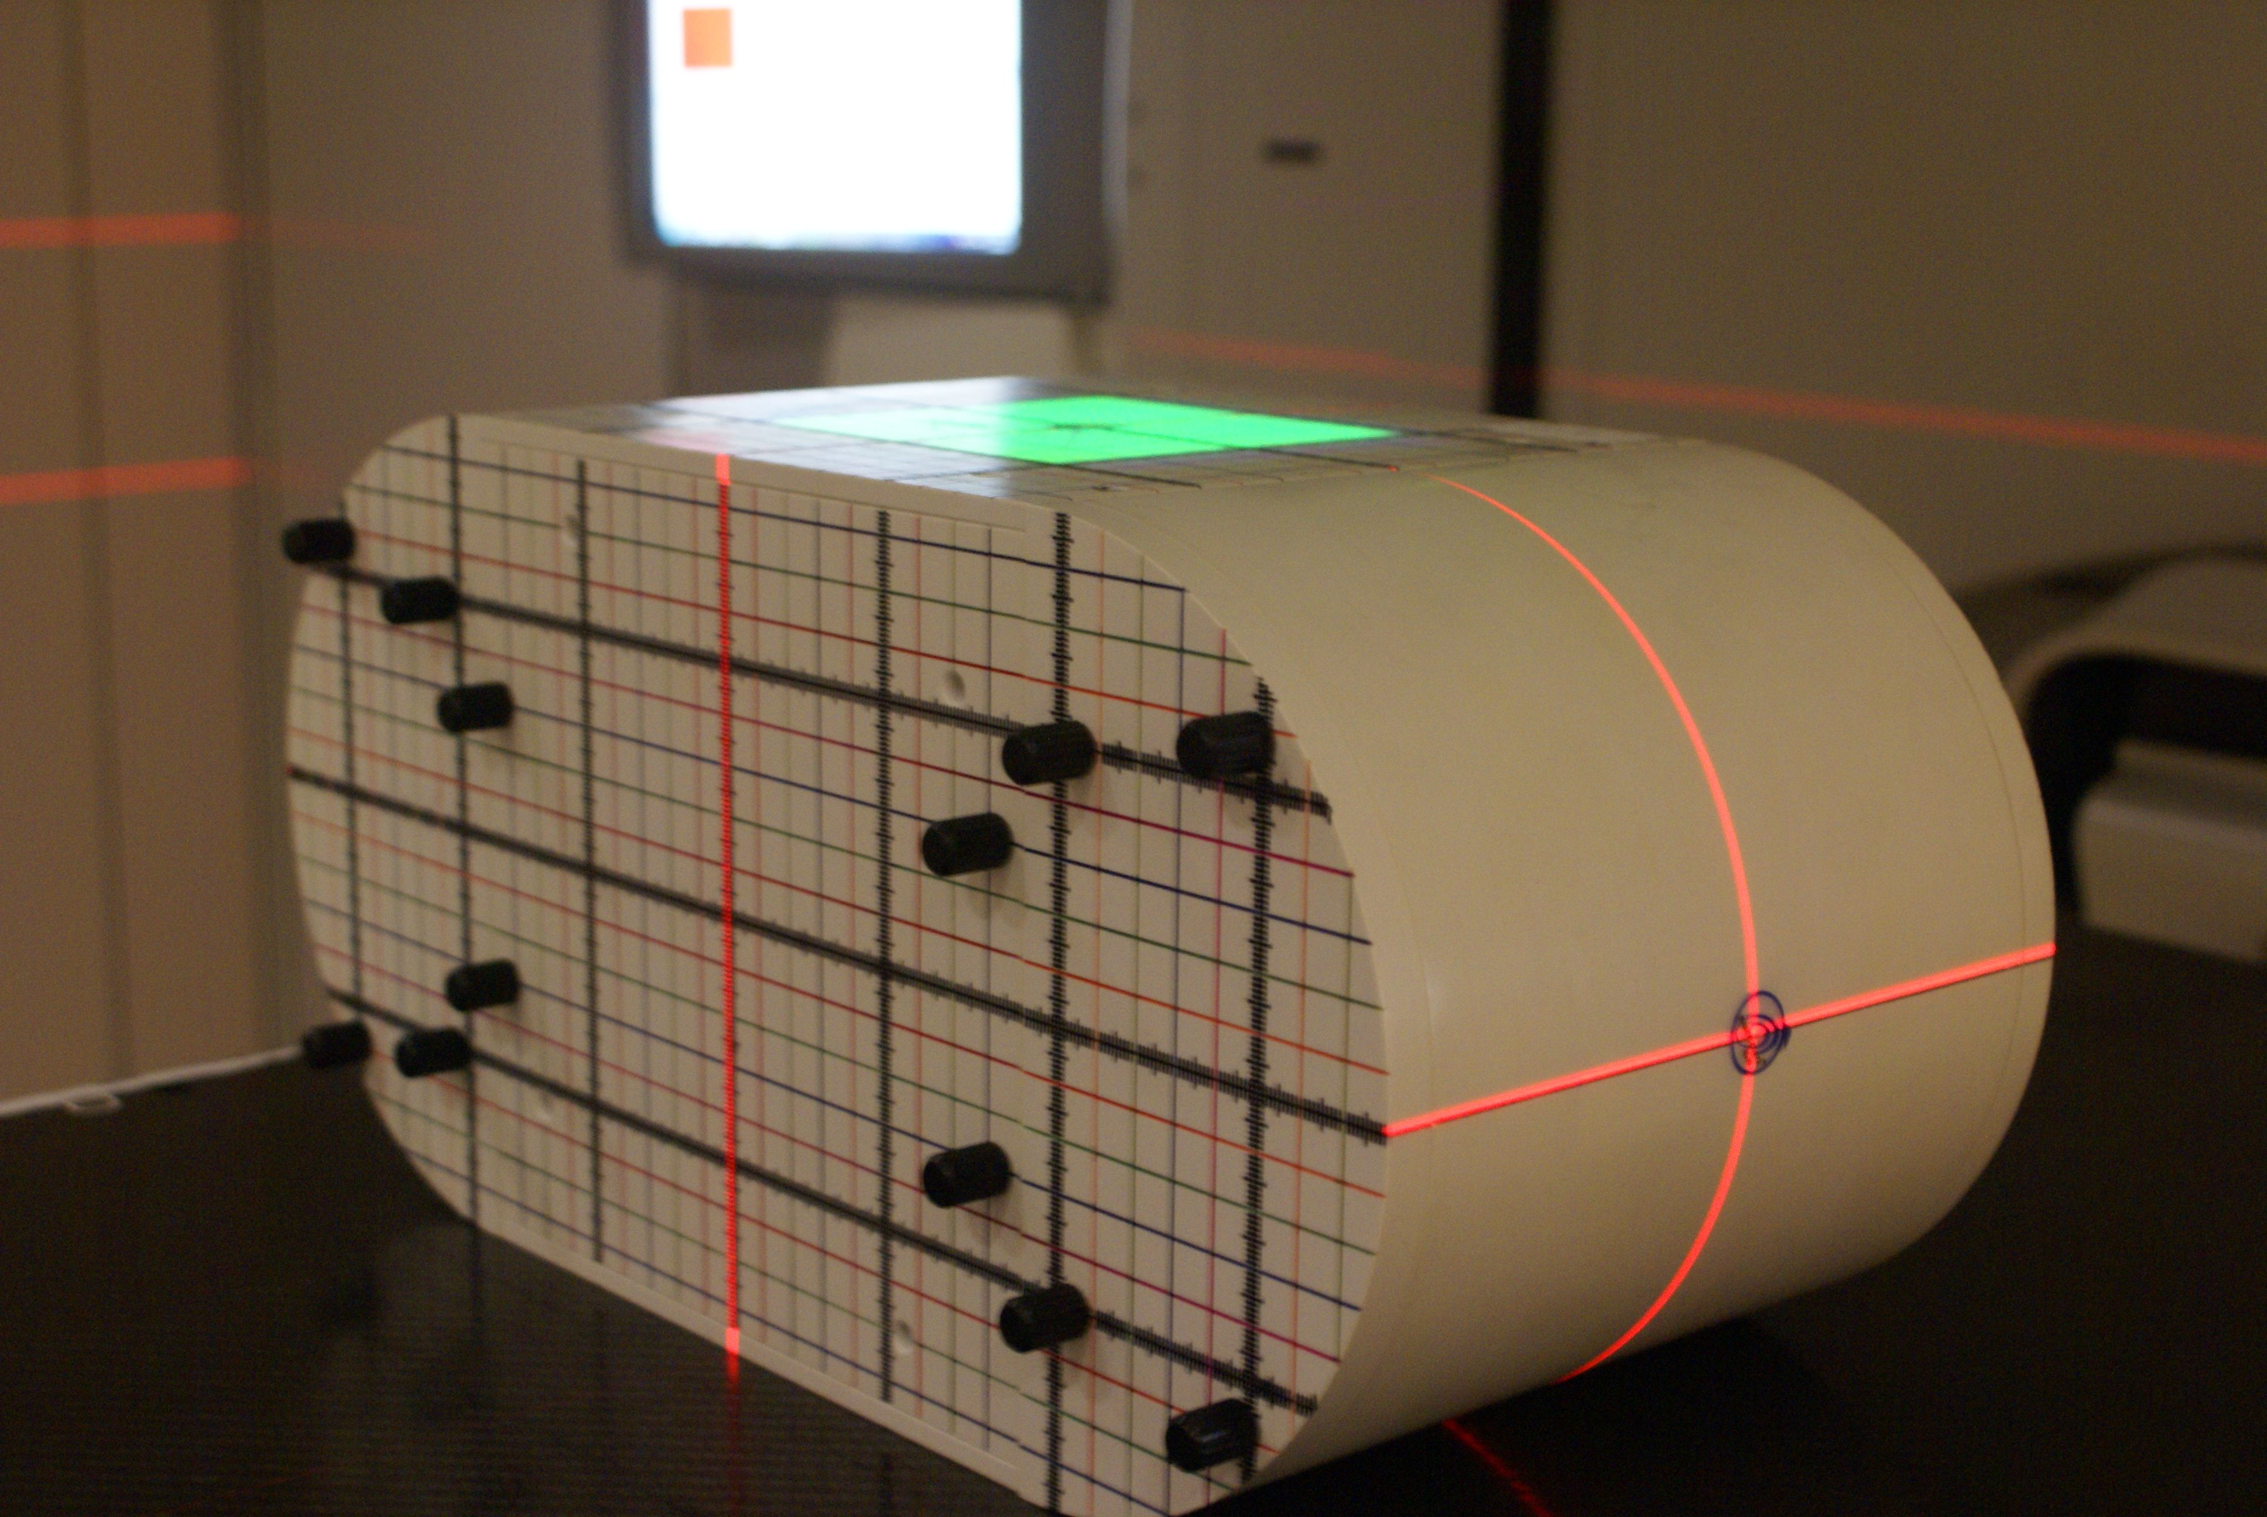
E2E tests: IMRT/VMAT
50%
80%
80%
50%

Slide 20
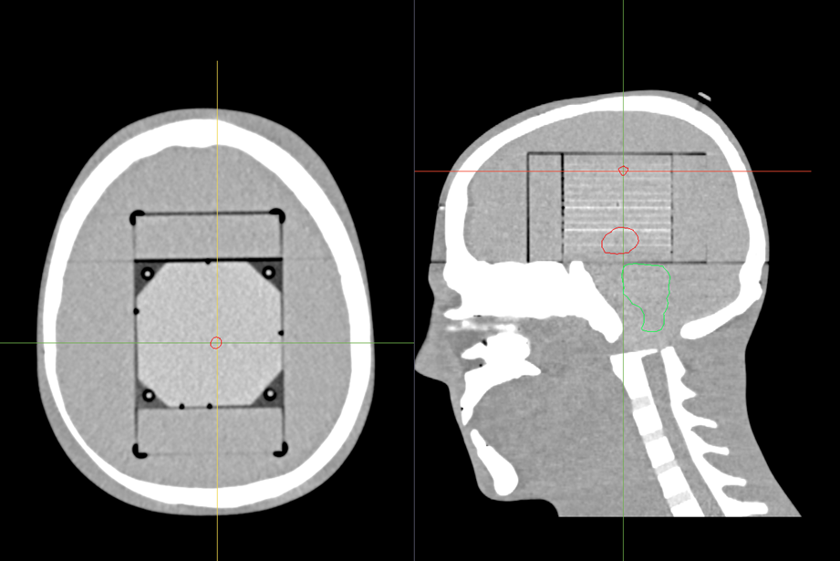
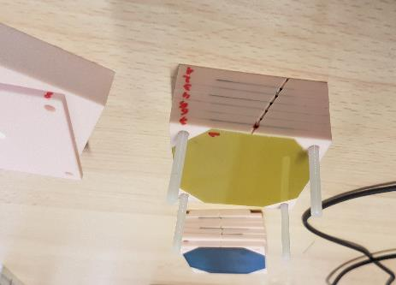
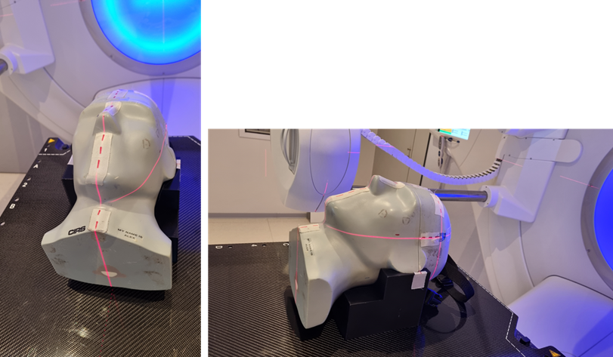
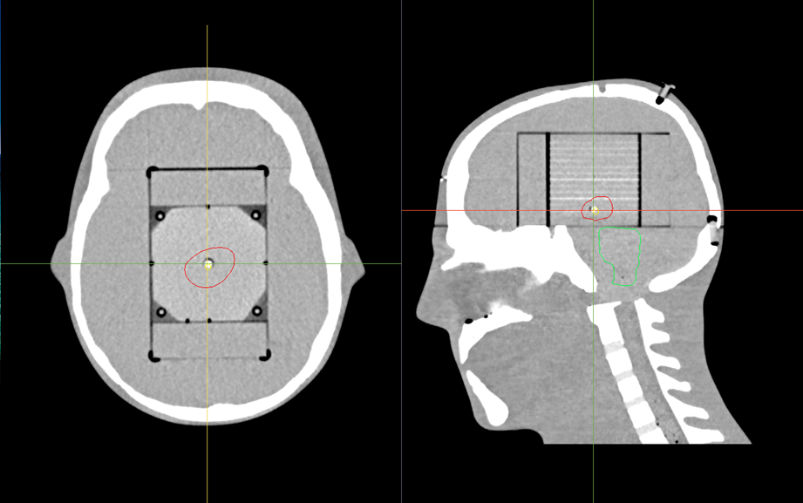
BELdART-SRS
STEEV phantom
Use 2 pieces of film
1 film in combination with alanine 1 film without alanine
Films are placed in axial plane
All the films are read together
Notes:
-water equivalent (no tumour material)
- Cushion ( as air equivalent TRANSPARANT as possible to not influence the dose to the head)

Slide 21
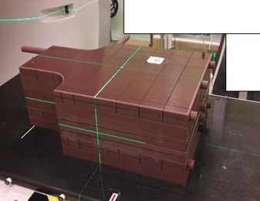
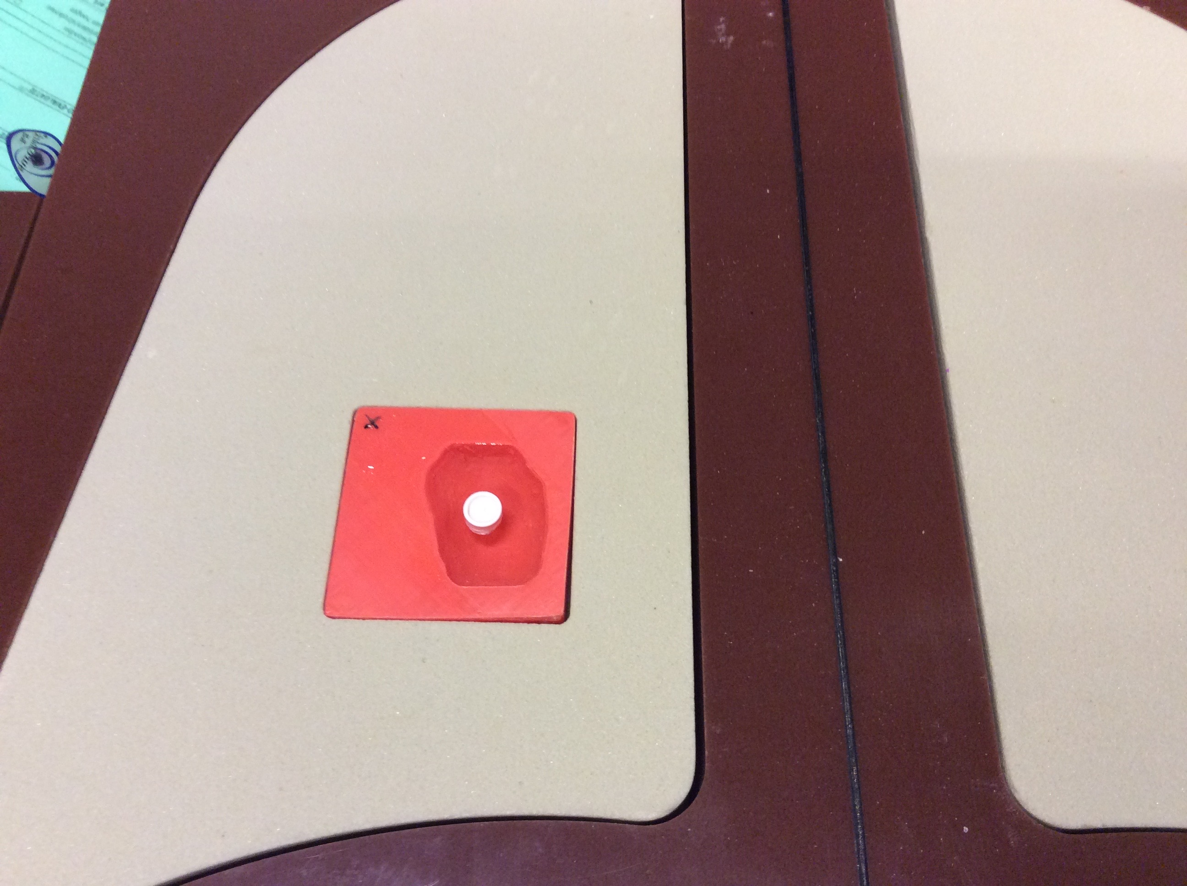
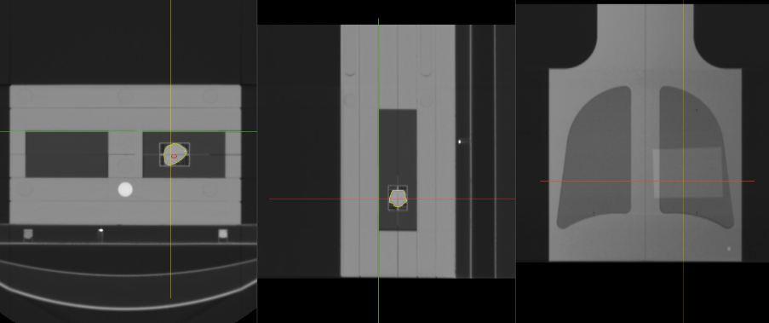
Beldart-SBRT
Film location through tumour
Alanine pellet
Film location on top of lungs

Slide 22
Some statistics since 2016 …
Number of audits: 79
Number of beams: 204 photons and electrons
Number of electron audit: 32
Number of basic tests only audits: 15
Number of photon VMAT audits: 79
Number of photon SRS audits: 46
Number of photon SBRT audits: 28

Slide 23
Basic tests

Slide 24
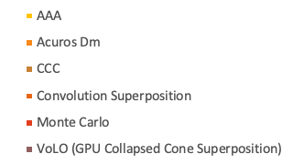
End2end: VMAT
3%
-3%

Slide 25
End2end: SRS
film

Slide 26
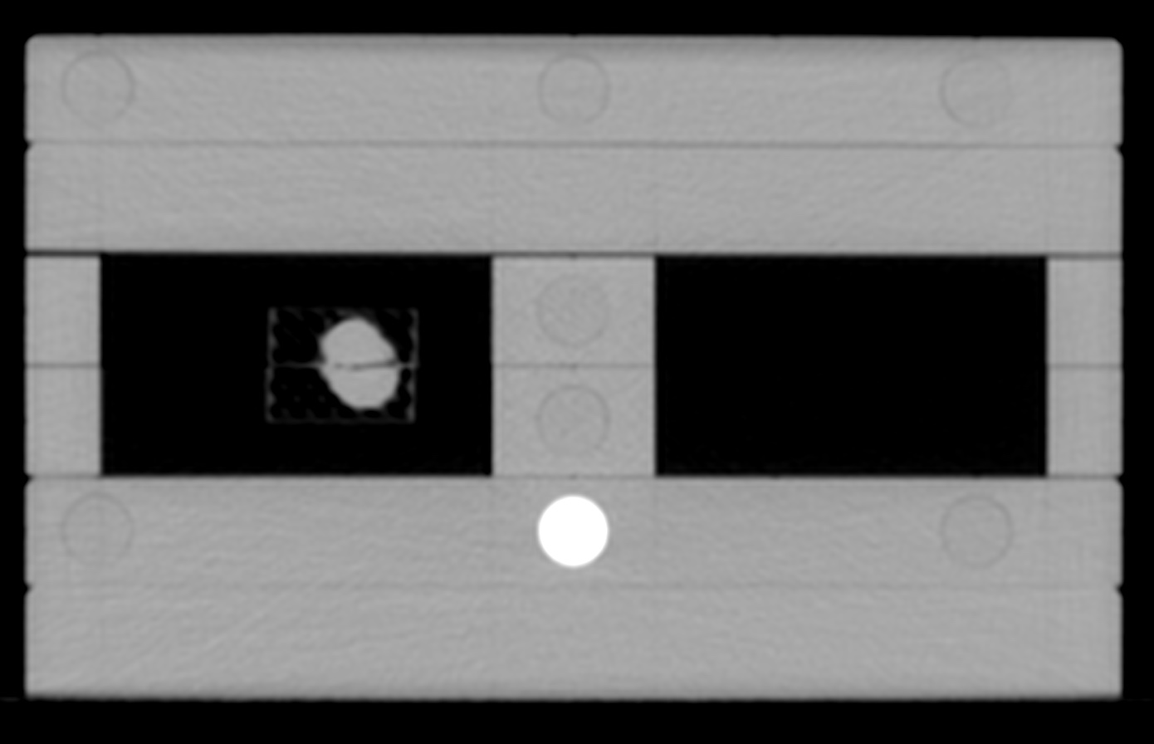
End2end: SBRT
film
w

Slide 27
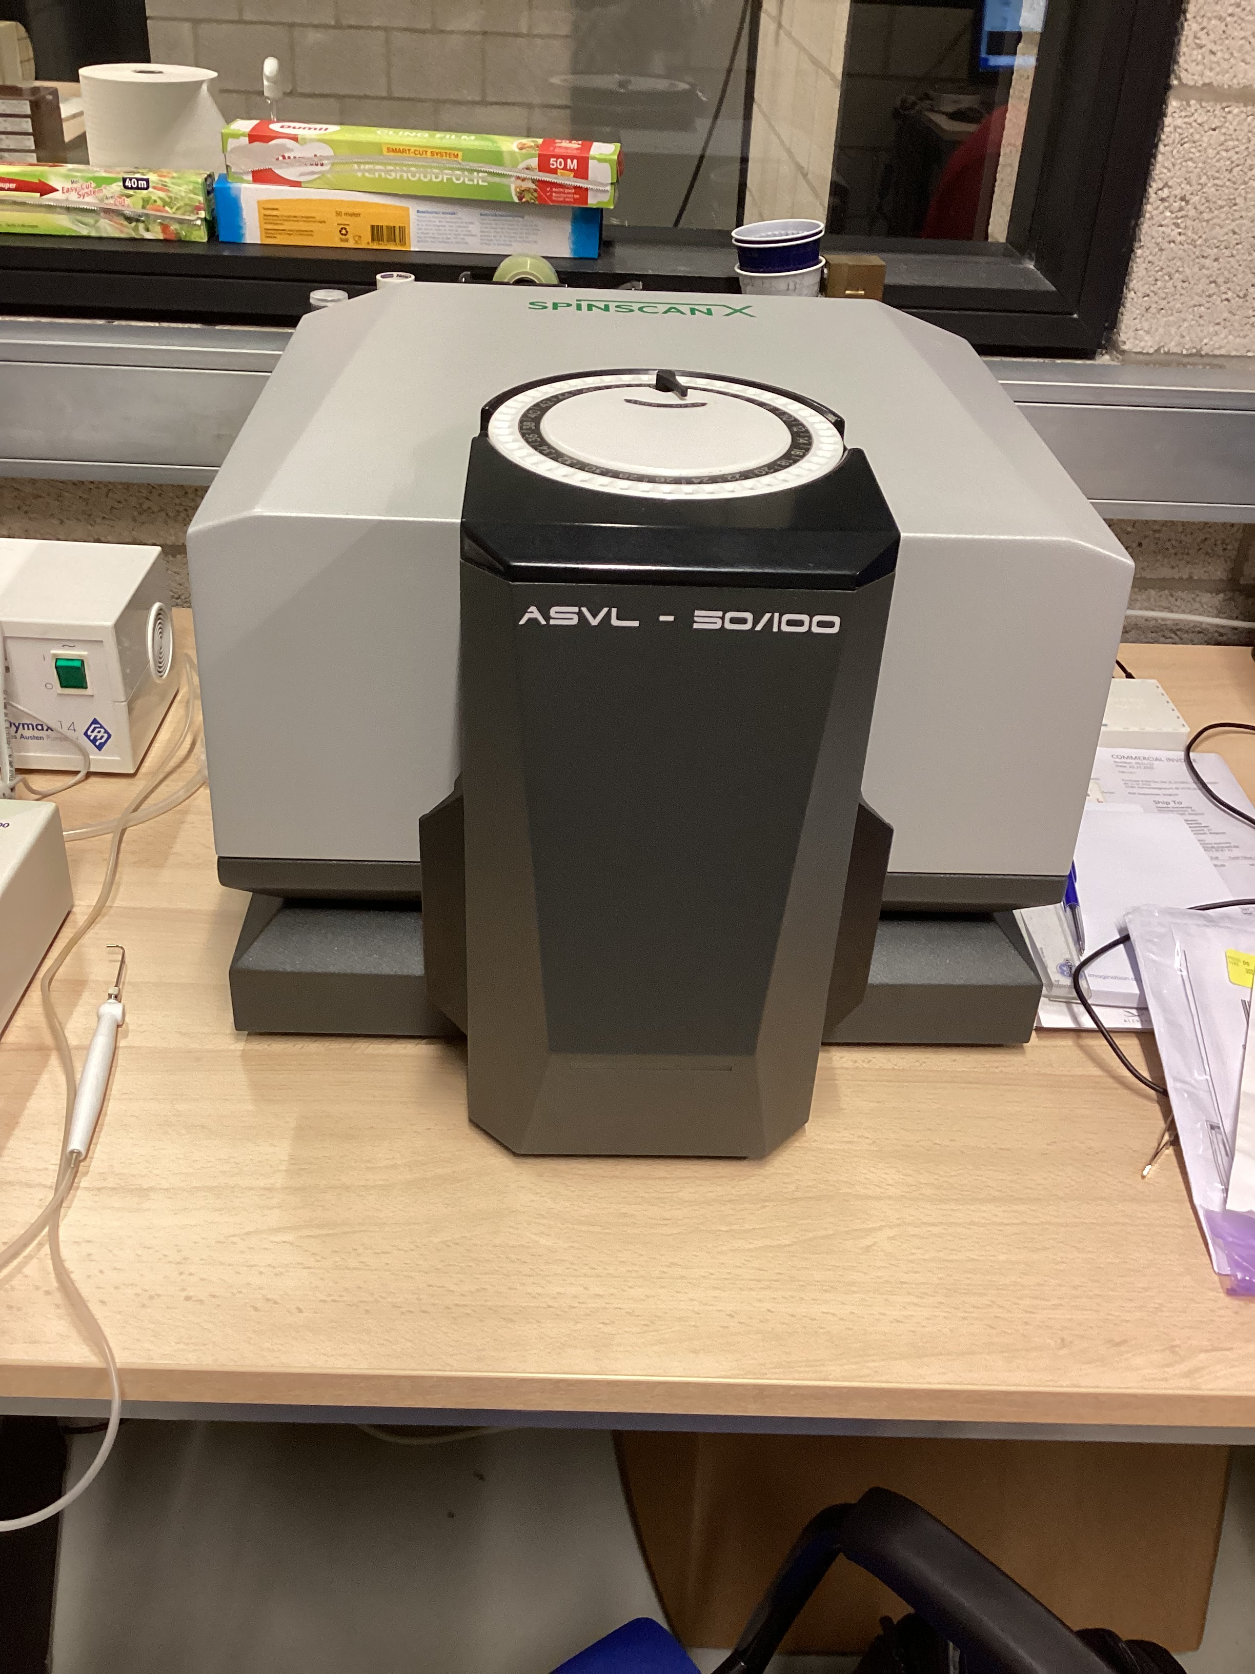
Future work
New table-top spectrometer
As backup for dosimetry (reference is ruby)
For higher doses?
Other materials?
Collaboration with CIBIO in France
Intercomparison planned with VSL in Catharina hospital in Eindhoven
Development of new phantoms
Breathing lung phantom (project with Maastro)
Expend the use of 3D printing
Brachytherapy!

Slide 28
Future work
New MR-linacs?
One test performed (no 3D printed supports to avoid air pockets)
MC models should be developed?
Testing of the new type of gafchromic film from Ashland: EBT4
Lots of data $→$ Possible studies:
Influence of the calculation algorithm?
Include complexity? (Code from Barcelona)
…
invesigate the effect of LET on the spectra.

Slide 29
BELdART
Call with Brigitte Reniers:
Any problems with the audits? ‘Not a lot of problems (+5%), only 1 center problem with reference dose. Unclear if the center resolved the issue and reaudited else.
More then 150 beams measured
Outliers in SRS or SBRT could not be measured again due to reasons
BELdART gets IAEA audits: within 1%
There seems to be no problem with BELdART audit but this is not how several centers feel. We need to feel confident in the procedure…
We should signal this feeling towards BELdART -> steering committee

Slide 30
Legislation

Slide 31
Legislation

Slide 32
Legislation
Important words:
External RT
+ 1 MeV
Before going clinically
External audit
Help and input from RT-24
Early ‘24

Slide 33
Legislation
Important words:
External RT: brachy is out of the scope
+ 1 MeV: KV contact is out of the scope

Slide 34
Legislation
What do we consider a minimum requirement for an external dosimetry audit?
Knowing that…….
timing is crucial in the process of commissionning a new machine
delay because of FANC/AFCN license issues
delay because of technical issues (infrastructure bunker/interlocks)
delay because of radiation protection
delay because of staffing problems, people getting ill,…
delay because of other priorities,….
delay because of ……..

Slide 35
Legislation
What do we consider a minimum requirement for an external dosimetry audit?
Knowing that…….
we buy machines for different modalities
machines for 3D
machines for IMRT
machines for VMAT
machines for (IMRT/VMAT) SRS
machines for (IMRT/VMAT) SBRT
machines for photons, electrons, protons
machines with surface scanning
machines with CBCT imaging, CT imaging, kV-imaging
machines with MRI imaging

Slide 36
Legislation
What do we consider a minimum requirement for an external dosimetry audit?
Do we need a simple reference field check, or do we feel comfortable if our complex treatment techniques are crosschecked?
Do we think a 10x10 reference field check is good practice if we will use the machine as a small field VMAT SRS treatment machine?
Maybe my machine is ready for conventional treatment (and pressure to go live as soon as possible) but it will take me some more months to get the complex SBRT treatment modelled in my TPS and validated.
Do we want to certify the external dosimetry audit or do I think it’s ok if my neighbouring RT department comes over to check my output?

Slide 37
Legislation
Proposal to start the discussion:
The minimal requirement for an external dosimetry before going clinically is a basic output test done by a certified external audit organism.
If the machine is intended for a specific treatment it is good practice to order an independant audit within the first 3 months of the start of the specific treatment.

Slide 38
Legislation
1.
2. Example and history of AZ Sint-Jan audit + re audit + finally Beldart on site with results which are satisfying, but loss of confidence in audit technique.
AZ St. Lucas had lots of problems:
Alanine was for several weeks at high temperature (35° C)
Measurements are rescaled to the output of the 10x10 reference field
Another centre came over to check the absolute dosimetry: was ok.
Hasselt experienced similar issues with basic audit test. They use Alanine in their centre and their own results are ok.
3. Proposal from Dirk Verellen to have an ionisation chamber measurement if the alanine measurement fails/is doubtful.
4. The basic test should be more robust - more professional.
5. Steering committee will put it on the agenda to discuss with BELdART
2.1 Legislation: important to keep the modalities in our own hands.
2.2 We need to be careful that the audit is feasable. In the same time we do think it's important to have a basic audit test for photons, protons, electrons before going clinically. There should be a transition period for specific techniques. We don't want specific techniques audits mandatory in the legislation. Lower the bar - but not to much.
2.3 The use of traffic light protocol to decide
2.4 Also beam matched machines need audit
2.5 Discussion on how electron audit could be performed. Only absolute dosimetry or some specific setup beams?
2.6 Can we audit ourselves as recognized MPE's or do we need a certified organism? The certified organism like BELdART itself is employing unrecognised employees. Do we list 'trained MPE's to audit?' In the past problems with that: the same MPE's have to go to audits all the time.
2.7 Concerning legislation: we should keep it simple, otherwise it will not be feasable to plan and accomplish the external audit

